Slide 1


Name : Shivasharanu
Date : July 14, 2025

Slide 2

Outline
Executive Summary
Introduction
Methodology
Results
Conclusion
Appendix

Slide 3
Executive Summary
Project Objective
To build a predictive model that determines the likelihood of Falcon 9 rocket first-stage landing success, enabling cost-effective launch decisions.
Key Methodologies
Data collection via SpaceX API + web scraping
Data cleaning & feature engineering (landing outcome, payload, site, etc.)
Exploratory Data Analysis (EDA)
Model building with Logistic Regression, SVM, Decision Tree, KNN
Model tuning using GridSearchCV with 10-fold cross-validation
Interactive visualizations using Plotly & Folium
Summary of all results
Best Model: Decision Tree
Cross-Validation Accuracy: 88.57%
Key Influencing Features: Launch Site, Payload Mass, Orbit

Slide 4
Introduction
Project Background & Context
SpaceX has revolutionized space transportation by making rocket reusability a core mission strategy.
The ability to successfully land the first-stage booster after launch is critical to reducing costs and ensuring sustainability.
Predicting the success of landings helps optimize planning, minimize risk, and improve operational efficiency.
This project aims to answer the following:
Can we predict whether a Falcon 9 first-stage booster will land successfully?
What factors (e.g., launch site, payload, orbit type) most influence landing success?
Which machine learning model gives the most accurate predictions?
How can this model support cost-effective and risk-aware launch decision-making?

Slide 5

Section 1

Slide 6
Methodology
Executive Summary
Data collection methodology:
Launch data was collected using the SpaceX REST API and web scraping from Wikipedia to compile relevant features like payload, launch site, and landing outcome
Perform data wrangling
The collected data was cleaned and structured by handling missing values, converting data types, and engineering new features for modeling.
Perform exploratory data analysis (EDA) using visualization and SQL
Perform interactive visual analytics using Folium and Plotly Dash
Perform predictive analysis using classification models
Four classification models—Logistic Regression, SVM, Decision Tree, and KNN—were trained to predict first-stage landing success.

Slide 7
Data Collection
The dataset was collected using two primary sources:
SpaceX REST API – to retrieve structured launch data (e.g., flight number, launch site, payload mass, orbit, landing success).
Wikipedia Web Scraping – to extract additional launch information such as booster version and detailed launch outcomes.
The collected raw data was then merged, filtered, and stored in structured format for further cleaning and analysis.

Slide 8
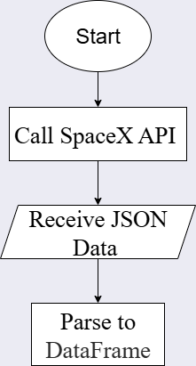
Data Collection – SpaceX API
Data was collected by making SpaceX REST API calls to retrieve structured launch data in JSON format, which was then parsed into a DataFrame for further processing.
GitHub URL of the completed SpaceX API calls notebook https://github.com/Shivasharanu-SN/Data-Science/blob/main/Applied%20data%20science%20project/jupyter-labs-spacex-data-collection-api-v2.ipynb

Slide 9
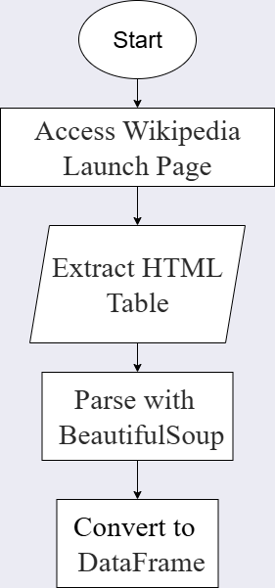
Data Collection - Scraping
Web scraping was performed on the Wikipedia Falcon 9 launch history page to extract tabular launch data using BeautifulSoup, which was then parsed into a structured DataFrame.
GitHub URL of the completed web scraping notebook https://github.com/Shivasharanu-SN/Data-Science/blob/main/Applied%20data%20science%20project/jupyter-labs-webscraping.ipynb

Slide 10
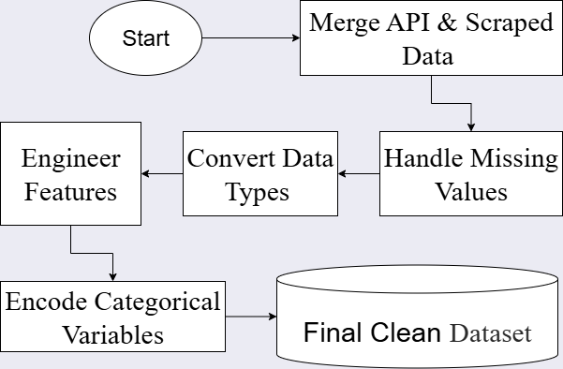
Data Wrangling
The collected data was processed by cleaning null values, converting data types, engineering new features (e.g., landing outcome), and preparing it for analysis and modeling.
GitHub URL of your completed data wrangling related notebooks https://github.com/Shivasharanu-SN/Data-Science/blob/main/Applied%20data%20science%20project/labs-jupyter-spacex-Data%20wrangling-v2.ipynb

Slide 11
EDA with Data Visualization
Various charts such as scatter plots, pie charts, bar graphs, and geospatial maps were used to explore feature distributions, analyze relationships (e.g., payload vs. success), compare launch site performance, and visualize geographical launch patterns to gain insights into the factors influencing landing success.
GitHub URL of your completed EDA with data visualization notebook https://github.com/Shivasharanu-SN/Data-Science/blob/main/Applied%20data%20science%20project/jupyter-labs-eda-dataviz-v2.ipynb

Slide 12
EDA with SQL
SELECT statements to retrieve key columns such as Launch Site, Payload Mass, and Mission Outcome.
WHERE clauses to filter data based on conditions like Landing Outcome = 'Success' or specific Launch Site.
GROUP BY queries to aggregate data by Launch Site and Orbit to count successes or failures.
ORDER BY to sort launch records by payload mass, success rate, or launch date.
COUNT() and AVG() functions to calculate total successful landings and average payload.
LIMIT to display top N results (e.g., top 5 successful sites).
GitHub URL of your completed EDA with SQL notebook https://github.com/Shivasharanu-SN/Data-Science/blob/main/Applied%20data%20science%20project/jupyter-labs-eda-sql-coursera_sqllite.ipynb

Slide 13
Build an Interactive Map with Folium
We created multiple interactive Folium maps to visualize launch site locations, proximity to key infrastructure, and outcomes of SpaceX missions using markers, circles, lines, and popups for detailed spatial insights.
Markers: Placed on launch sites and key locations (e.g., coastline, cities) to visually represent their coordinates and roles in analysis.
CircleMarkers: Used to indicate launch sites with varying color or size to reflect success/failure status.
Lines (PolyLines): Drawn between launch sites and nearest features (e.g., coastline, railways, highways) to show proximity and analyze logistic relationships.
Popup Labels / Tooltips: Added to markers to display detailed information like site name or distance.
Distance Markers (DivIcon): Used to display the calculated distances between launch sites and nearby features directly on the map.
GitHub URL of your completed interactive map with Folium map https://github.com/Shivasharanu-SN/Data-Science/blob/main/Applied%20data%20science%20project/lab-jupyter-launch-site-location-v2.ipynb

Slide 14
Build a Dashboard with Plotly Dash
The dashboard was built using Plotly Dash, incorporating interactive components like pie charts, scatter plots, dropdowns, and sliders to explore SpaceX launch data dynamically.
Pie Chart: Shows overall success distribution across all launch sites or compares success vs. failure for a selected site — helps understand site-wise performance.
Scatter Plot: Displays the relationship between payload mass and landing success — used to identify trends or thresholds affecting outcomes.
Dropdown Menu: Allows users to select a specific launch site or view data for all sites — enables targeted analysis.
Range Slider: Lets users filter payload mass range — helps explore how different payload sizes impact success rate.
Dynamic Updates: All charts respond to user inputs (site selection, payload range) — makes the dashboard interactive and user-driven.
Add the GitHub URL of your completed Plotly Dash lab, as an external reference and peer-review purpose https://github.com/Shivasharanu-SN/Data-Science/blob/main/Applied%20data%20science%20project/spacex-dash-app.py

Slide 15
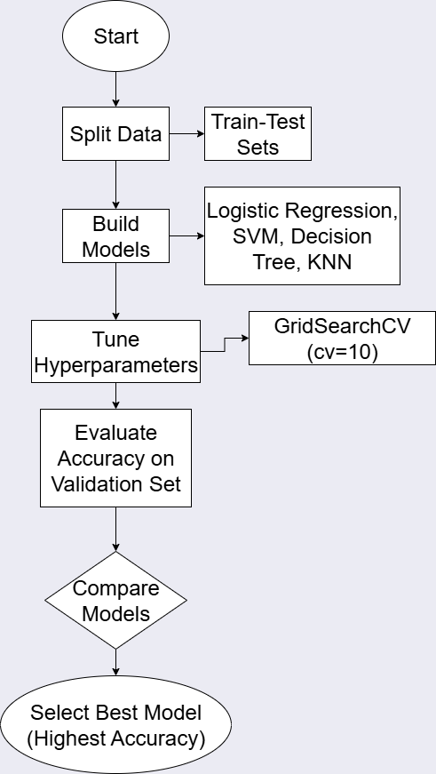
Predictive Analysis (Classification)
We built multiple classification models (Logistic Regression, SVM, Decision Tree, KNN), tuned them using GridSearchCV with 10-fold cross-validation, evaluated them using accuracy scores, and selected the best-performing model based on validation performance.
GitHub URL of your completed predictive analysis lab https://github.com/Shivasharanu-SN/Data-Science/blob/main/Applied%20data%20science%20project/SpaceX-Machine-Learning-Prediction-Part-5-v1.ipynb

Slide 16
Results
Exploratory data analysis results
Launch success was found to vary significantly by launch site, orbit, and payload size.
Payloads within a moderate range showed higher success rates compared to extreme values.
Interactive analytics
The dashboard allowed dynamic filtering by launch site and payload range.
Visual updates in pie and scatter plots provided real-time exploratory insights.
Predictive analysis results
Among all models, Decision Tree performed best with the highest validation accuracy.
Launch Site, Orbit, and Payload Mass were key predictors of landing success.

Slide 17

Section 2

Slide 18
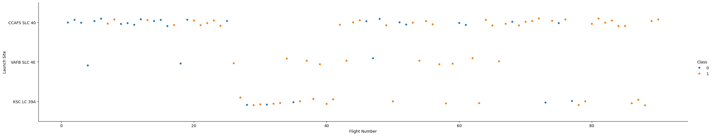
Flight Number vs. Launch Site
The scatter plot of Flight Number vs. Launch Site shows how launches are distributed over time across different sites.
It helps identify launch frequency patterns and site activity progression throughout SpaceX’s mission history.

Slide 19
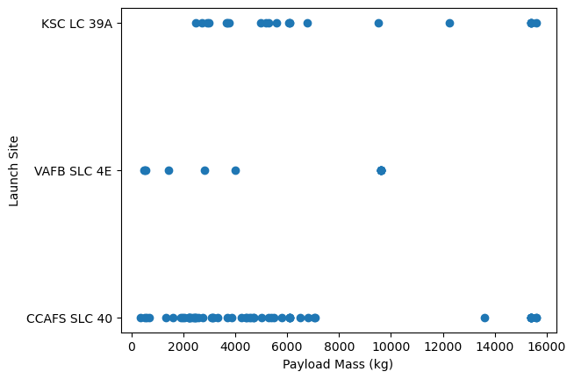
Payload vs. Launch Site
The scatter plot of Payload Mass vs. Launch Site reveals how different sites handled varying payload sizes.
It highlights that some launch sites are associated with heavier or more frequent payload missions, aiding in capacity analysis.

Slide 20
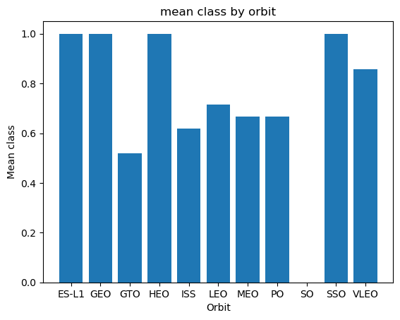
Success Rate vs. Orbit Type
The bar chart displays the landing success rate for each orbit type, helping compare performance across mission profiles.
It shows which orbits (e.g., GEO, SSO) are associated with higher success rates, supporting mission planning and risk analysis.

Slide 21
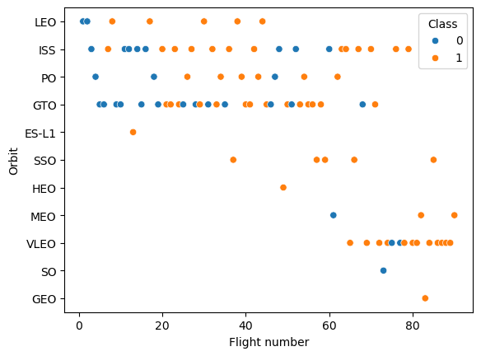
Flight Number vs. Orbit Type
The scatter plot of Flight Number vs. Orbit Type illustrates how orbit selection has evolved over time across missions.
It reveals trends such as increased use of certain orbits (e.g., VLEO or ISS) as SpaceX expanded its launch capabilities.

Slide 22
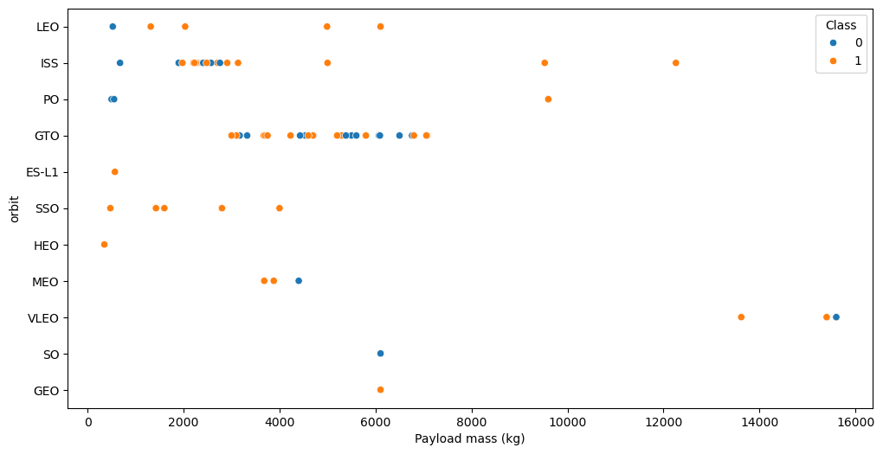
Payload vs. Orbit Type
The scatter plot of Payload Mass vs. Orbit Type shows how different orbits are associated with varying payload capacities.
It helps identify which orbits typically carry heavier or lighter payloads, providing insight into mission design constraints.

Slide 23
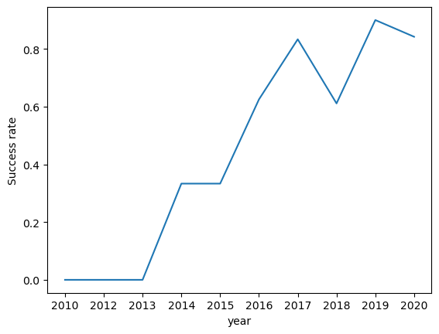
Launch Success Yearly Trend
The line chart shows the average landing success rate per year, tracking SpaceX’s performance over time.
It highlights a clear upward trend, indicating consistent improvement in landing reliability year over year.

Slide 24
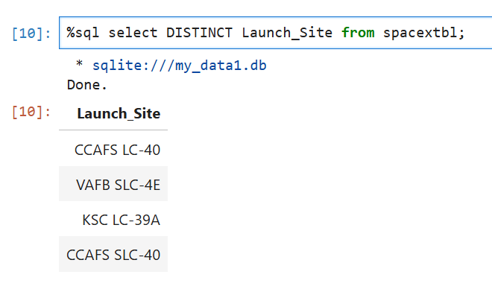
All Launch Site Names
This query retrieves all distinct launch site names from the dataset, helping identify where SpaceX launches have taken place. These sites are used to analyze launch performance and frequency.

Slide 25
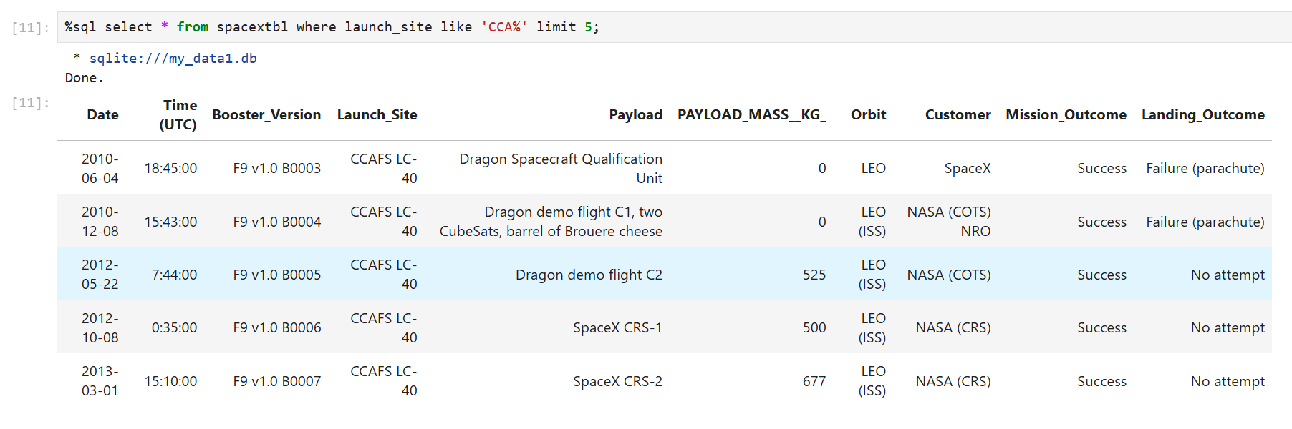
Launch Site Names Begin with 'CCA'
This query filters the dataset to show the first five launch records where the launch site name starts with "CCA", which stands for Cape Canaveral Air Force Station. These sites are frequently used by SpaceX for missions to various orbits.

Slide 26
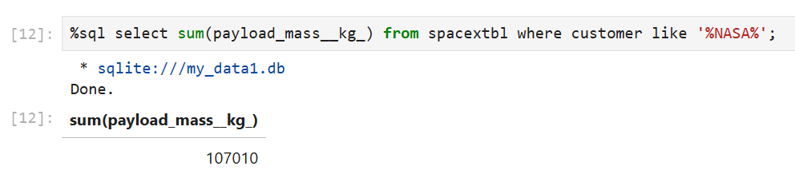
Total Payload Mass
This query calculates the total payload mass (in kg) carried by boosters for missions that involved NASA as a customer. The %NASA% pattern ensures that all entries mentioning NASA (e.g., “NASA (CRS)”, “NASA/ULA”) are included in the total.

Slide 27
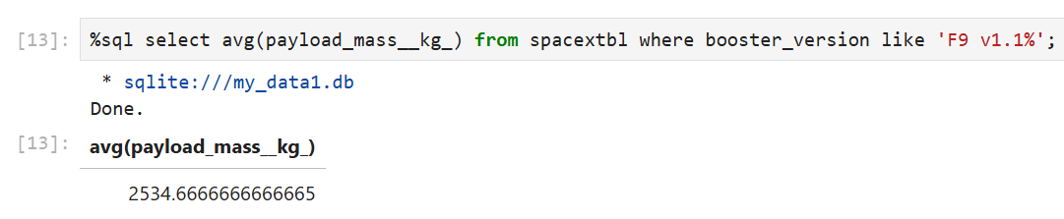
Average Payload Mass by F9 v1.1
This query calculates the average payload mass (in kg) carried specifically by the F9 v1.1 booster version. It helps assess the typical mission capacity of that particular Falcon 9 configuration.

Slide 28
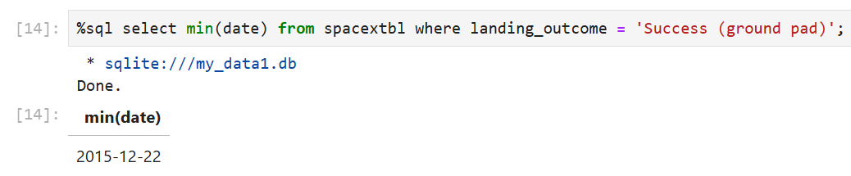
First Successful Ground Landing Date
This query finds the earliest date on which SpaceX achieved a successful landing on a ground pad, showcasing a major milestone in their reusability goals. The MIN() function returns the first such occurrence.

Slide 29
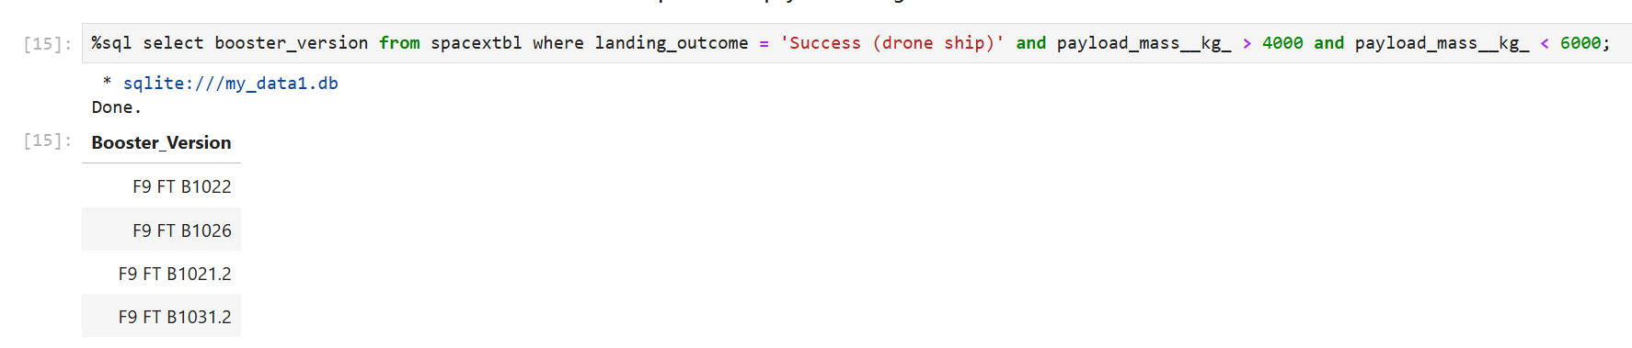
Successful Drone Ship Landing with Payload between 4000 and 6000
This query lists the distinct booster versions that successfully landed on drone ships and carried payloads between 4000 kg and 6000 kg. This highlights boosters capable of mid-weight missions with precise drone ship recovery.

Slide 30
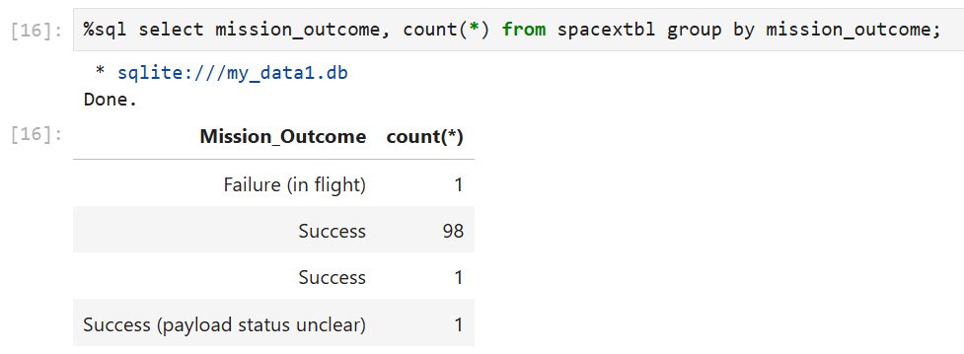
Total Number of Successful and Failure Mission Outcomes
This query groups all missions by their outcome type and counts how many times each occurred. It provides a quick summary of SpaceX’s overall success and failure rates across all launches.

Slide 31
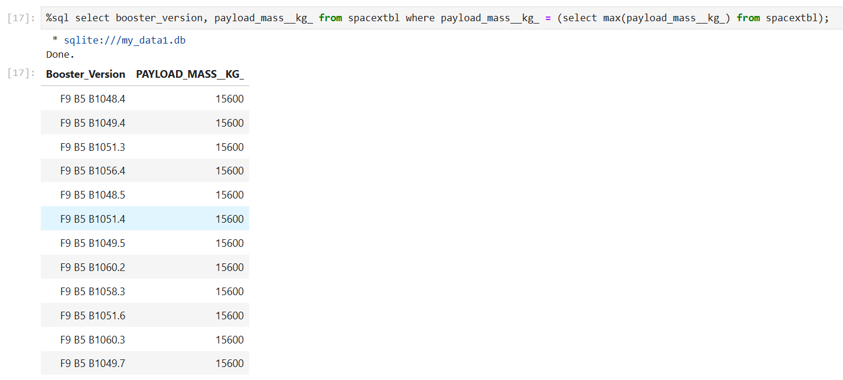
Boosters Carried Maximum Payload
This query identifies the booster version(s) that carried the heaviest payload ever recorded in the dataset. It uses a subquery to fetch the maximum payload and returns the corresponding booster(s).

Slide 32
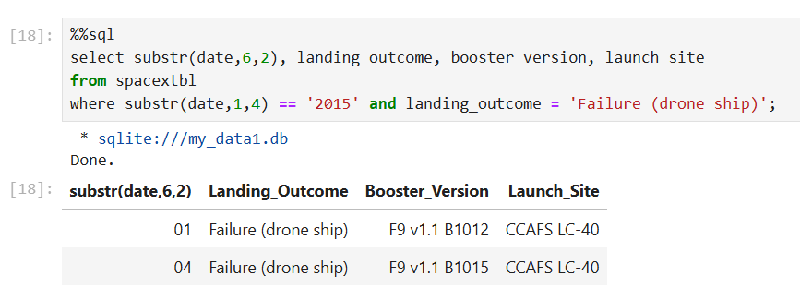
2015 Launch Records
This query filters for missions in the year 2015 that attempted to land on a drone ship but failed, showing their booster versions and launch sites. It highlights early challenges SpaceX faced in landing recovery.

Slide 33
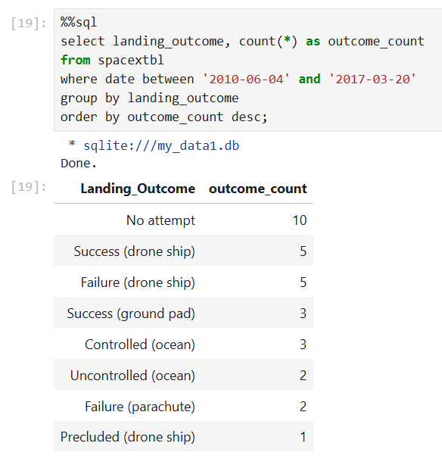
Rank Landing Outcomes Between 2010-06-04 and 2017-03-20
This query ranks the frequency of landing outcomes during the specified date range in descending order, helping identify which types of landings were most common or problematic during SpaceX’s early landing development phase.

Slide 34

Section 3

Slide 35
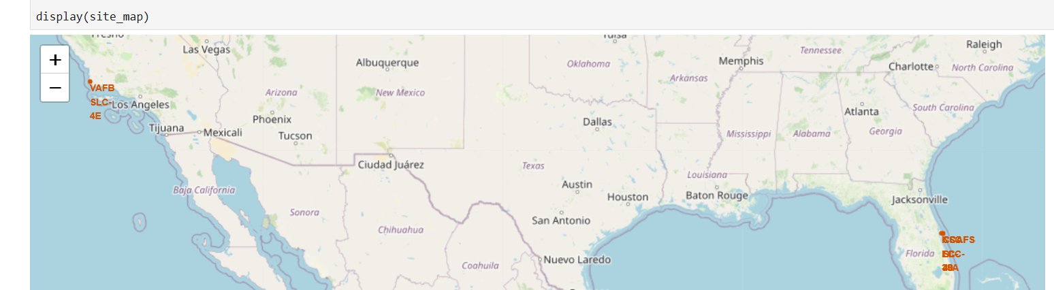
Global Map of SpaceX Launch Sites
Location Markers: Each marker on the map represents a SpaceX launch site, placed using their real-world geographic coordinates.
Popup Labels: Clicking on a marker reveals the launch site name, helping identify its location (e.g., CCAFS, VAFB, KSC).
Geographic Spread: All launch sites are concentrated in the United States, indicating SpaceX's centralized operations.
Visual Insight: This map provides a spatial understanding of SpaceX’s infrastructure distribution, essential for analyzing logistical and trajectory factors in launches.

Slide 36
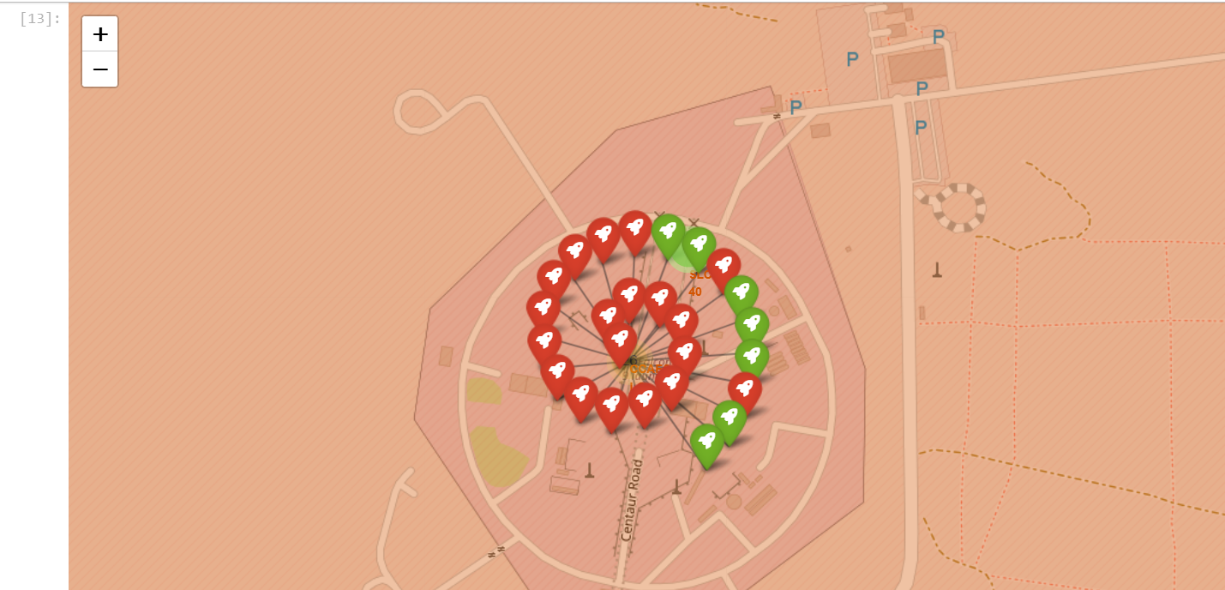
Launch Outcomes Visualized by Color on Global Map
Color-Coded Markers: Each marker’s color represents the launch outcome — for example, green for success and red for failure.
Enhanced Context: This visual overlay provides immediate feedback on launch performance by location.
Geographic Trends: You may observe that certain sites have higher success rates, while others show mixed outcomes, giving clues to operational maturity or complexity of missions.

Slide 37
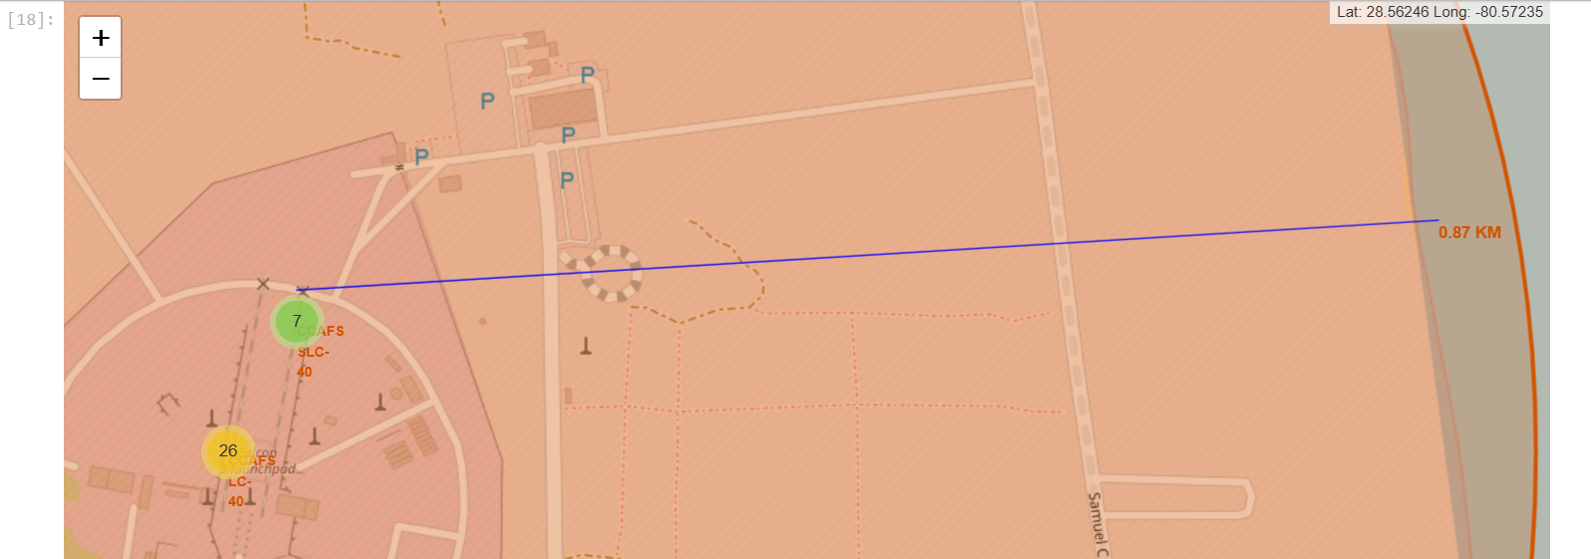
Launch Site Proximity Analysis with Distance Markers
Selected Launch Site: A highlighted marker indicates the launch site (e.g., CCAFS LC-40).
Proximity Lines: Lines connect the launch site to nearby coastline, railway, and highway points.
Distance Labels: Each line includes a label displaying the calculated distance (in KM) between the launch site and the respective feature.
Insight: This visual helps assess the strategic accessibility of the launch site for logistics, recovery operations, and safety planning.

Slide 38

Section 4

Slide 39
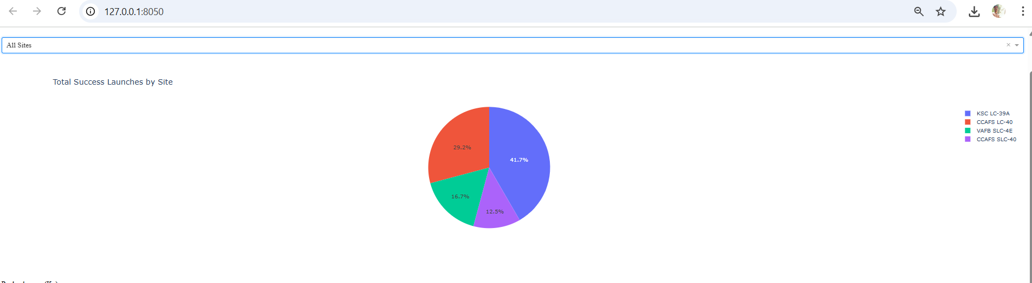
Launch Success Count Across All Sites
Pie Chart Segments: Each slice represents a launch site and its proportion of successful launches.
Comparative View: The chart highlights which sites have contributed most to successful missions, offering a quick glance at operational hotspots.
Insight: Sites like KSC LC-39A or CCAFS LC-40 may show larger shares, indicating higher usage and reliability.

Slide 40
Success vs. Failure Breakdown for Top Performing Launch Site
Focused Analysis: This pie chart zooms in on the launch site with the highest success ratio (e.g., KSC LC-39A).Segment
Breakdown: It visually compares the count of successful vs. failed launches from that specific site.
Insight: A large green (success) segment indicates strong operational performance, suggesting the site's maturity, infrastructure advantage, or mission-critical role.

Slide 41
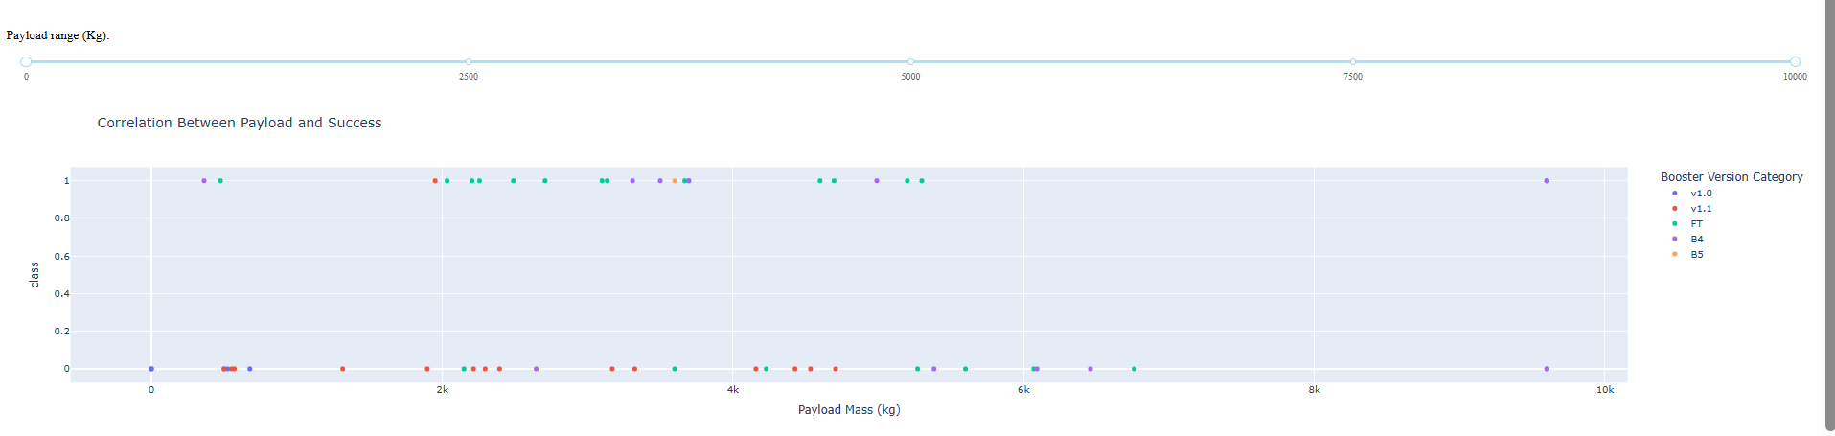
Payload Mass vs. Launch Outcome Across All Sites
Scatter Plot Dynamics: Each point represents a launch, plotted by payload mass and launch outcome, color-coded for success or failure.
Range Slider Interaction: The payload range slider filters launches to explore trends in different payload categories (e.g., light vs. heavy missions).
Insight: Success rates tend to be higher for payloads under 6000 kg. Boosters like F9 FT and F9 Block 5 show strong success clusters, indicating reliability for medium to heavy payloads.

Slide 42

Section 5

Slide 43
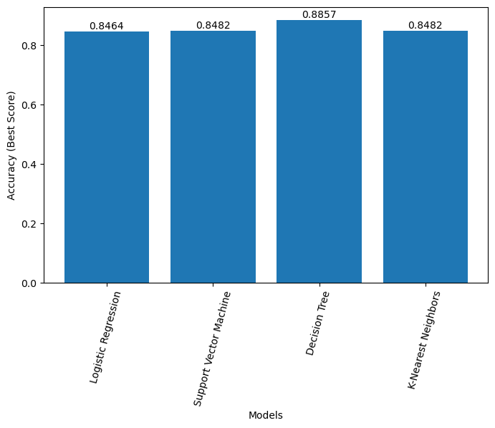
Classification Accuracy
Bar Chart Representation: Each bar displays the classification accuracy of a model (e.g., Logistic Regression, SVM, Decision Tree, KNN).
Clear Comparison: The visual makes it easy to compare the performance of different models on the validation/test set.
Insight: The model with the highest classification accuracy Decision Tree demonstrates the best predictive performance in this SpaceX launch success classification task.

Slide 44
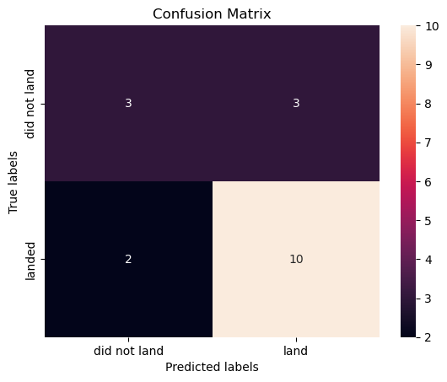
Confusion Matrix
True Positives (TP): Cases where the model correctly predicted a successful launch.
True Negatives (TN): Cases where the model correctly predicted a failure.
False Positives (FP): Cases where the model predicted a success, but it was a failure.
False Negatives (FN): Cases where the model predicted a failure, but it was a success.
Insights: The confusion matrix provides a detailed evaluation of the model's performance beyond overall accuracy. The high number of true positives and true negatives in the matrix confirms that the model is reliable in both predicting launch successes and failures. Low false positives/negatives further suggest balanced prediction capability.

Slide 45
Conclusions
SpaceX launch activity is concentrated at a few key U.S. sites, with varying success rates influenced by site infrastructure and mission complexity.
Exploratory data analysis revealed patterns between payload mass, orbit type, and launch outcomes, aiding in identifying risk factors for launch failure.
Interactive visualizations using Folium and Plotly Dash provided clear insights into spatial logistics and operational performance.
Among the classification models built, the best performing model Decision Tree achieved the highest accuracy, making it suitable for predicting future mission outcomes.
Data-driven decision-making is feasible for launch reliability analysis, showcasing how machine learning and visualization can support aerospace operations.

Slide 46
Appendix
GitHub link of project : https://github.com/Shivasharanu-SN/Data-Science/tree/main/Applied%20data%20science%20project

Slide 47


